Slide 1

CONTACT
MANAGER
COP4331 Group 1

Slide 2
CONTRIBUTORS
Joshua Chappelle
Ishan Patel
Front End
Database
API
Alvin Abraham
Alexander Lokhanov
API
API
Christian Gomez
Brandon Stewart
Front End
Project Manager

Slide 3







Organization
Communication
TECHNOLOGY
USED
JIRA
GitHub
Discord
LAMP stack
Linux
Apache
MySQL
PHP

Slide 4
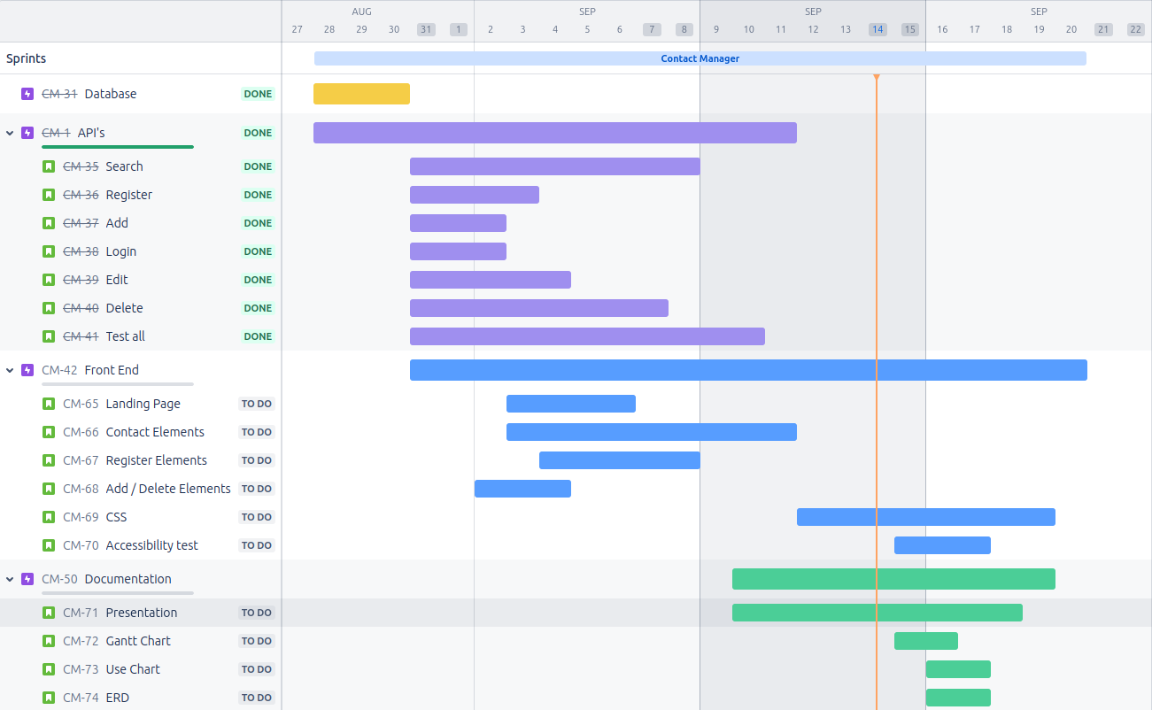
GANTT CHART
API Team
Josh
Chris
8/28/24 - 8/31/24
12fsfsd
Front end Team
Alex
Alvin
Project Manager
Brandon
Database Team
Ishan

Slide 5
THE GOOD
Great Communication
Quick responses
Availability
Deadlines
Adherence to target due dates
Communicated slow downs
Teamwork
Helped each other with knowledge gaps
Everyone quickly took on and learned their roles
Organization
Used Jira and Git to track work
Regular check ins to check progress

Slide 6
Debugging
Spent a whole day wondering why data wasn’t being saved in database. Forgot to connect all API's
Getting a text input box to center on the screen
Front End
Different Design ideas
JavaScript / CSS/ HTML learning curve
API
Knowledge gap when it came to creating API's. Lack of SQL, PHP
Using postman to test the API was also an unknown
Different Browsers
Would work on firefox but not on chrome for some
Had to clear cache often to get site to load
THE BAD

Slide 7
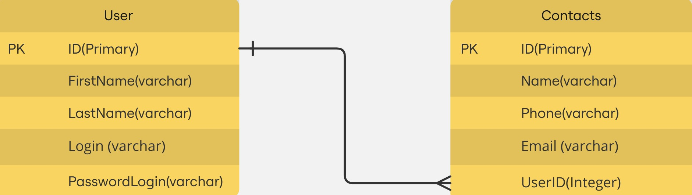
ERD

Slide 8


User Error
Search Contact
Register
<extends>
<includes>
Create Contact
Login information
<extends>
Authenticate
<includes>
Update Contact
USER
Login
DATABASE
Delete Contact
Log Out

Slide 9

ACCESIBILITY SCORE
100
100
100
100
100

Slide 10
API DEMONSTRATION
DEMO

Slide 11
APP DEMONSTRATION
DEMO

Slide 12
QUESTIONS?

